Slide 1
MinSeg Linear Dynamical Model and Feedback Control
EE 547 (PMP) Final Project
Winter 2015
Paul Adams
Chris Schulenberg

Slide 2
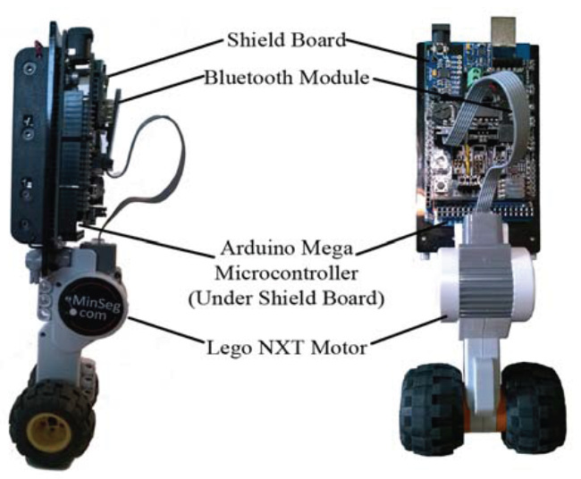
MinSeg Model
Non-Linear System
State-Space Representation about equilibrium point
Arduino SoC and MinSeg sensors enable real-time measurement of state variables

Slide 3
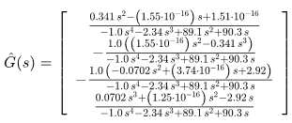
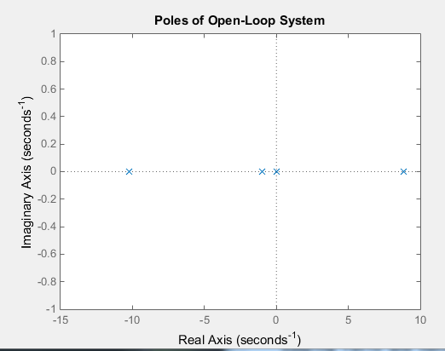
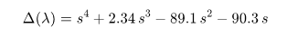
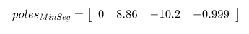
Stability
Transfer Function
Choose Pole location analysis to determine stability.
Conclusion:
Open-loop system unstable!

Slide 4
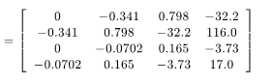
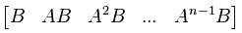
Controllability
Choose Controllability Matrix analysis to determine controllability of model
Controllability matrix has full row rank
Conclusion: MinSeg is controllable

Slide 5
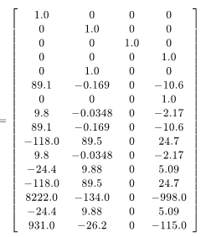
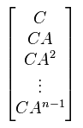
Observability
Choose Observability Matrix analysis to determine observability of model
Observability matrix has full row rank
Conclusion: MinSeg is observable

Slide 6
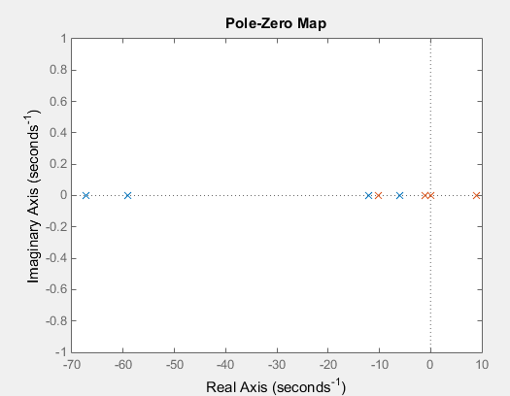
Controller
Choose to place the poles to provide the controller with 6 times the bandwidth of the open-loop model.
A_{CL} = A – B*K
Conclusion: Closed-loop system is stable

Slide 7
Estimator
Choose to place the poles to provide the observer with 6 times the bandwidth of the open-loop model.
Simulate system with observer and plot error
Conclusion: Observer tracks system states within a tight tolerance

Slide 8
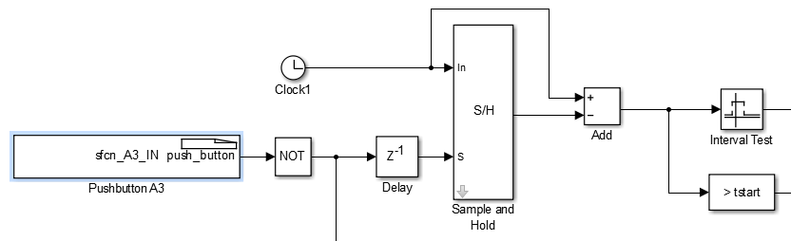
Robot/Demonstration
Challenges
Software
Raw sensor data
Linking the model to the MinSeg
What worked
Three batteries
Reset pushbutton
GitHub

